Slide 1

4.3
“FUN” damentals of Biomechanics
IB Says: “In this sub-topic No Calculations are required”

Slide 2
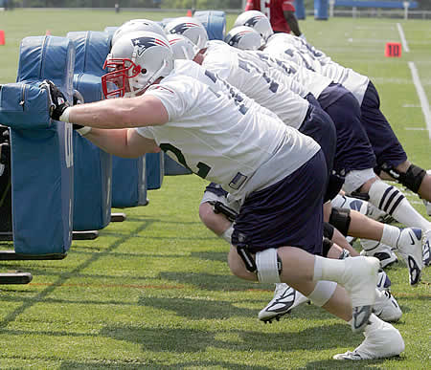
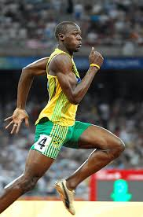
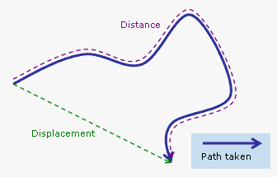
4.3.1 Define the terms force, speed, velocity, displacement, acceleration, momentum and impulse.
Force = a directional push or pull on an object
(if unopposed will cause a change in motion)
Speed = distance per unit of time without direction (ex. m/s, km/hr )
Velocity= displacement per time in a given direction
(both speed and velocity may be instananeous or average)
Displacement= the length and direction of a straight line from start and end of motion (different from distance which has no direction!)

Slide 3
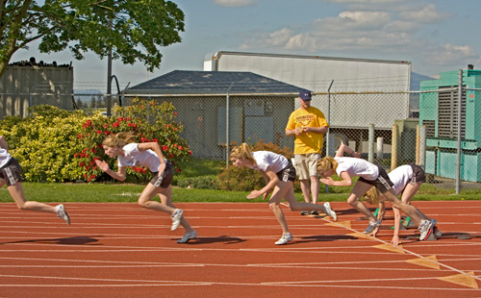
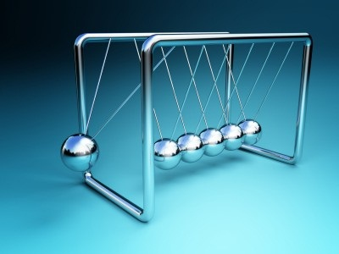
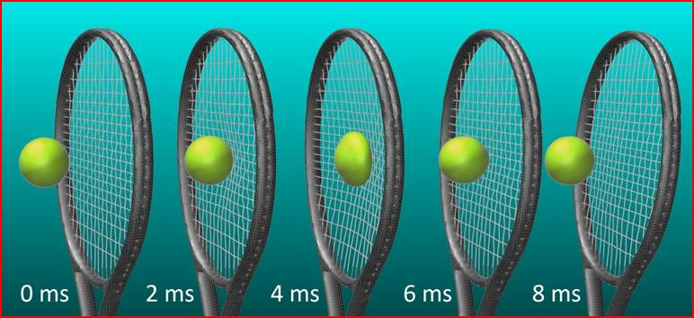
Acceleration= the change in velocity per unit of time (ex. m/s/s or m/s²)
Momentum (p)= mass x velocity
Impulse = a force and the time over which it is applied (Imp.= F x ∆t)

Slide 4
Scalar or Vector?
Scalar- a measurement that has only a magnitude (size) but no particular direction.
Vector- a measurement that has both magnitude AND direction
Which of the previous measurments are scalars and which are vectors?
SCALARS:
Speed
Distance
VECTORS:
Force
Velocity
Displacement
Acceleration
Momentum
Impulse

Slide 5
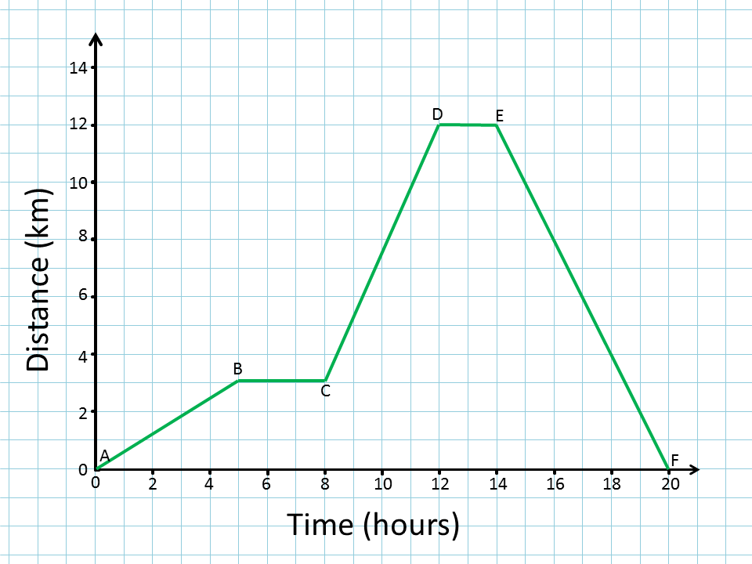
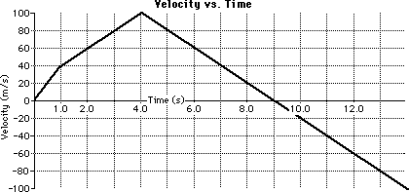
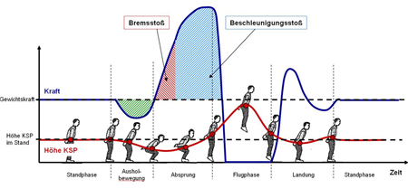
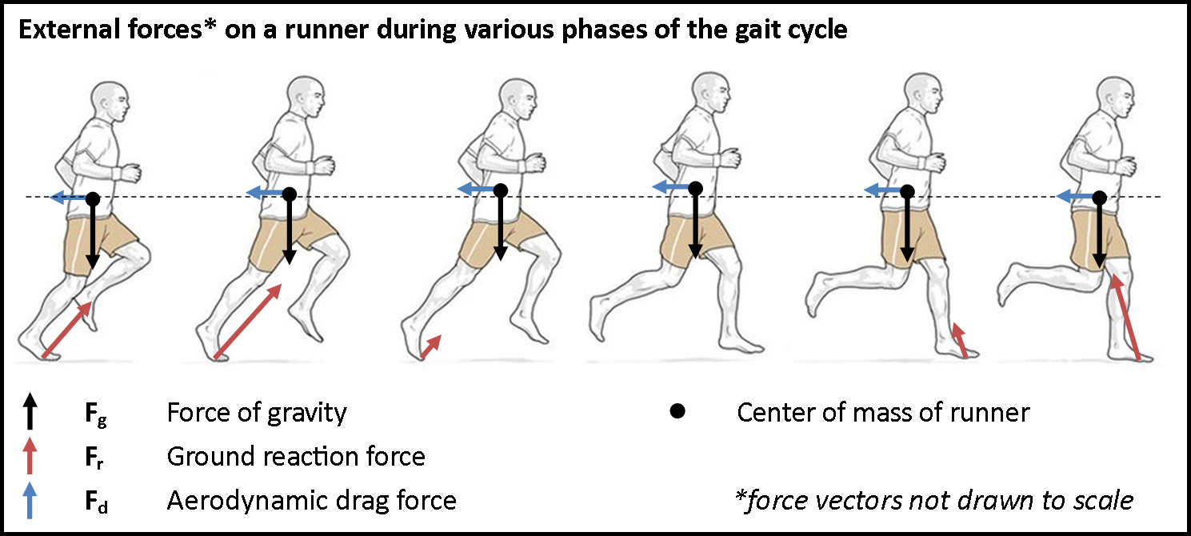
4.3.2 Analyze velocity–time, distance– time and force–time graphs of sporting actions
Application: Vernier Motion and Force Sensors-

Slide 6
4.3.3 Define the term center of mass.
Center (or “centre” according to IB) of Mass-
Depends on the distribution of material in a body or object.
Affected by density and shape of object.
Therefore, for humans center of mass moves as the body moves.
Think of center of mass this way: The point at which if a force were applied it would move the object in a given direction but NOT cause rotation. Hmm…
Extension- Center of mass of a billiard ball? Of a donut? Of a boomerang? Of Dick Fosbury?
Can the center of mass of an object lie outside of the body itself???
YES!!!

Slide 7
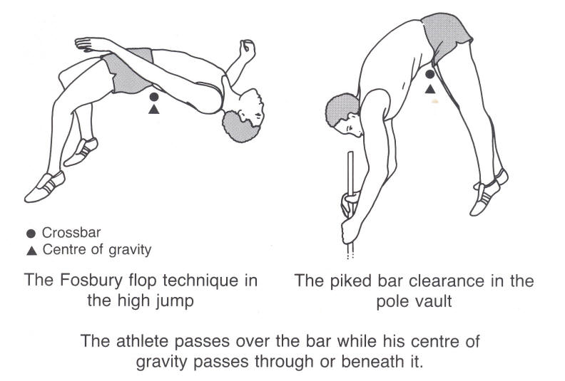
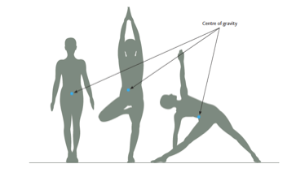
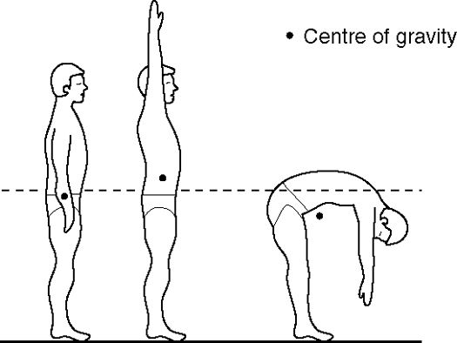
4.3.4 Explain that a change in body position during sporting activities can change the position of the center of mass. Give examples.
Center of Gravity- Males vs. Females?

Slide 8
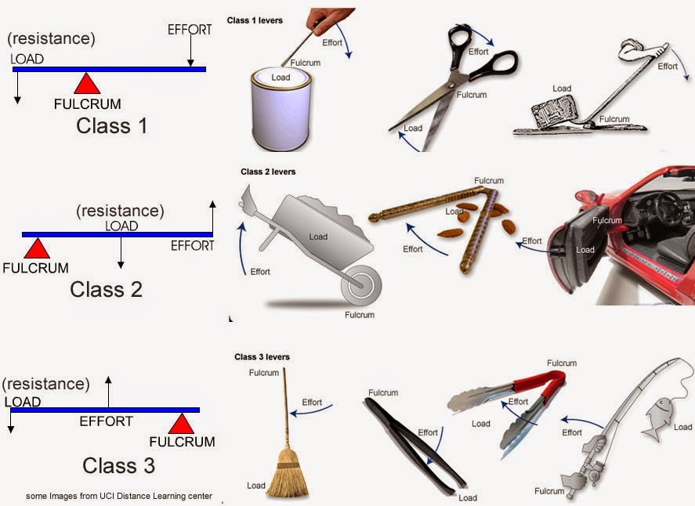
4.3.5 Distinguish between first, second and third class levers.
The 3 Classes of Levers-
Depends on where the load (resistance) and the effort (applied force) lie in relation to the fulcrum (pivot point)
1st Class: The fulcrum lies between the effort and the load
2nd Class: The load lies between the effort and fulcrum
3rd Class: The effort lies between the load and fulcrum

Slide 9
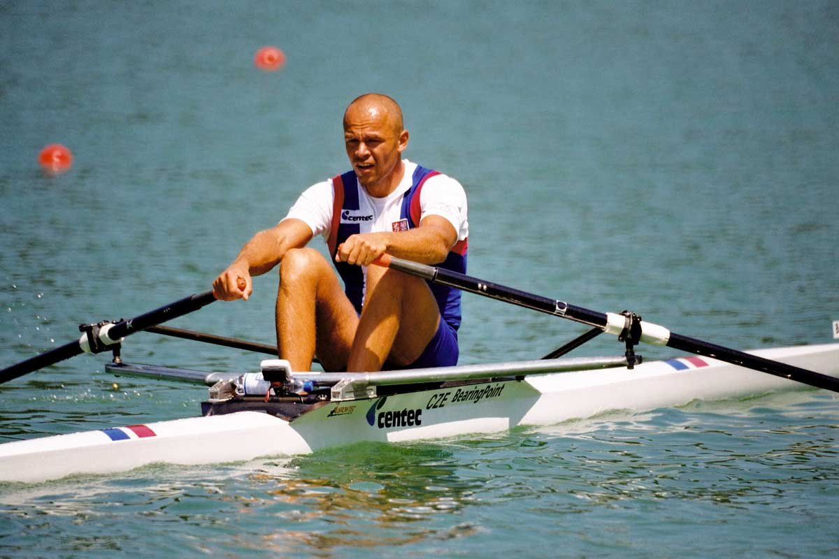
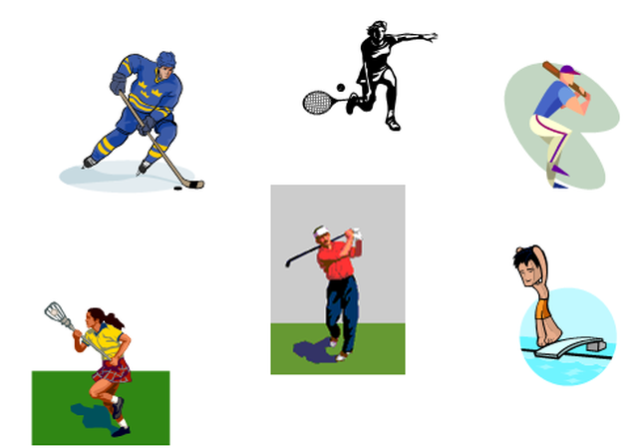
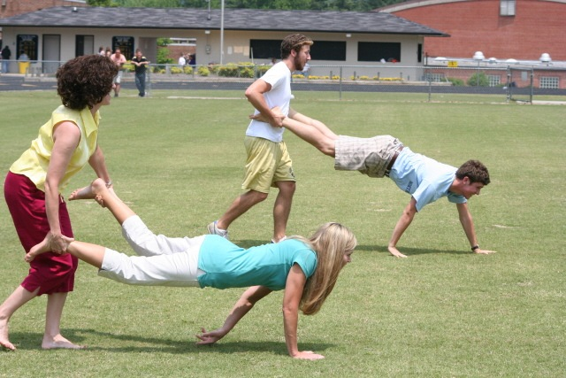
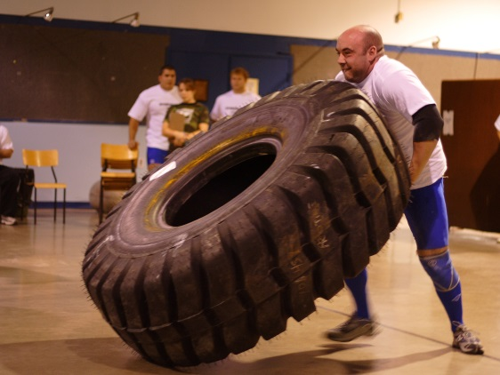
What kind of levers are in sports?
1st
3rd
2nd

Slide 10
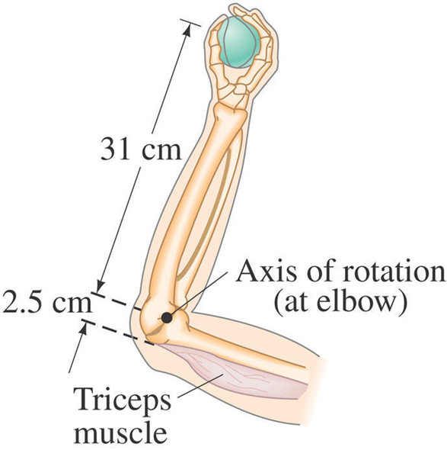
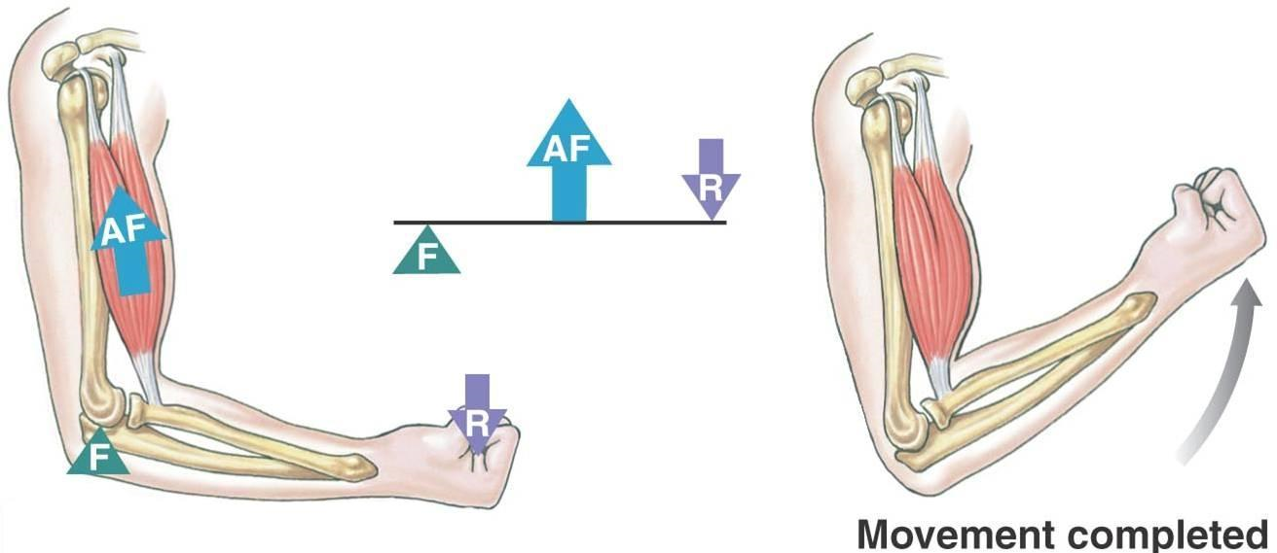
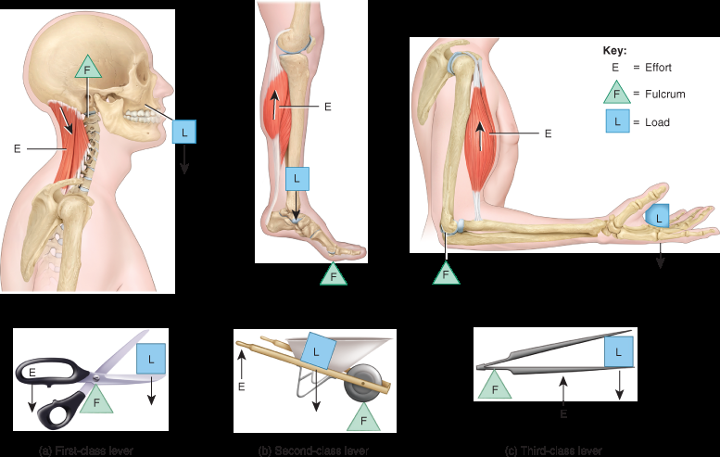
4.3.6 Label anatomical representations of levers. (Limit to Biceps-Elbow, Triceps Elbow, and Calf-Ankle)

Slide 11
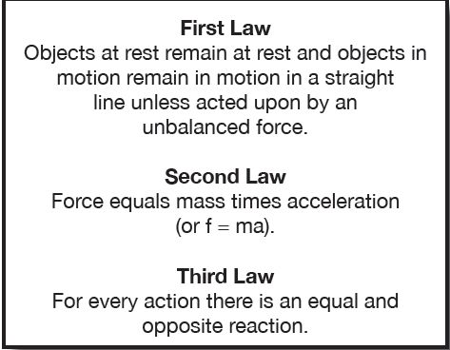
4.3.7 Define Newton’s three laws of motion.

Slide 12
4.3.8 Explain how Newton’s three laws of motion apply to sporting activities.
First Law- Soccer Ball? Hockey Puck?
Second Law- Accelerating a Ping Pong ball versus soccer ball? Weights of objects and athletes?
Third Law- Sprinter starting from blocks? 2 hockey players push each other? Paddling a kayak?

Slide 13
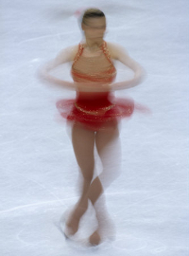
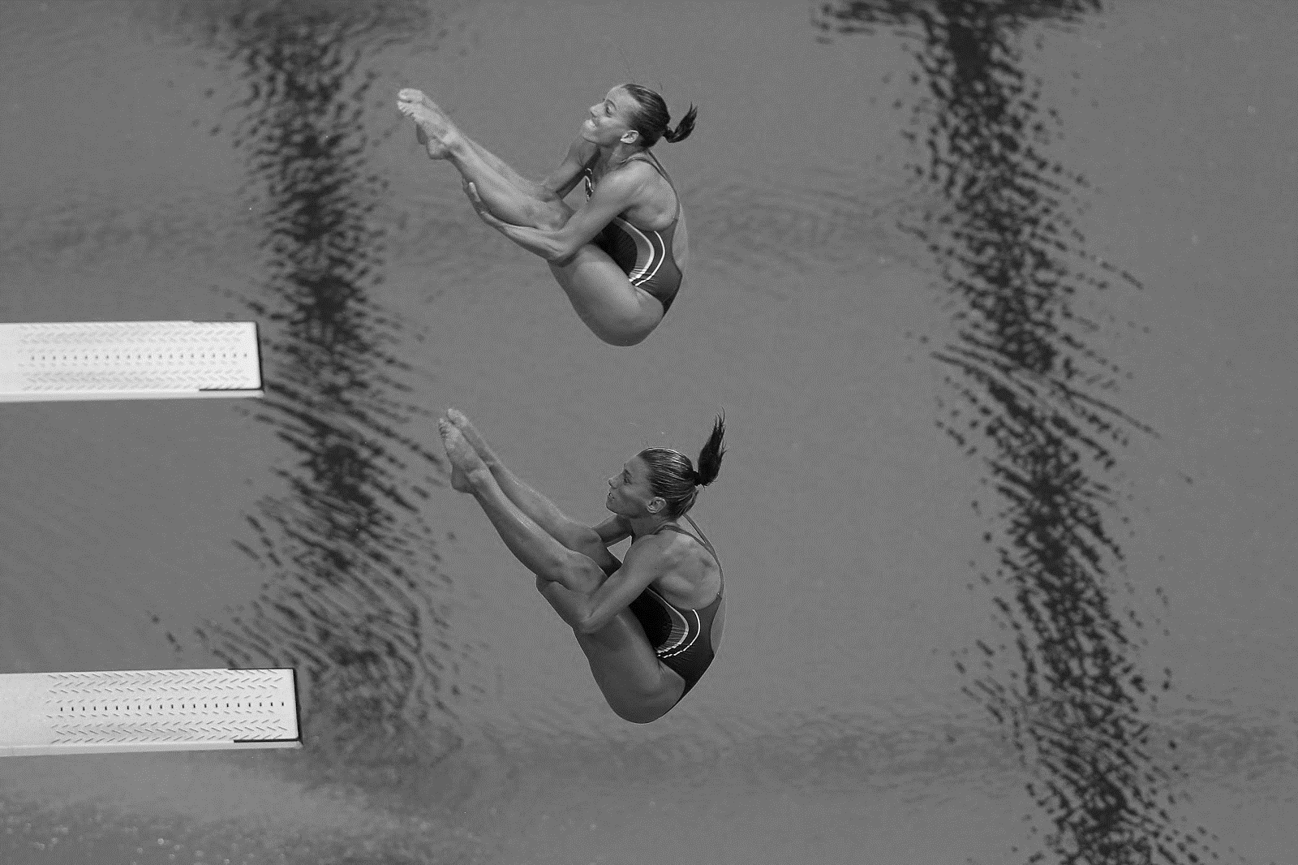
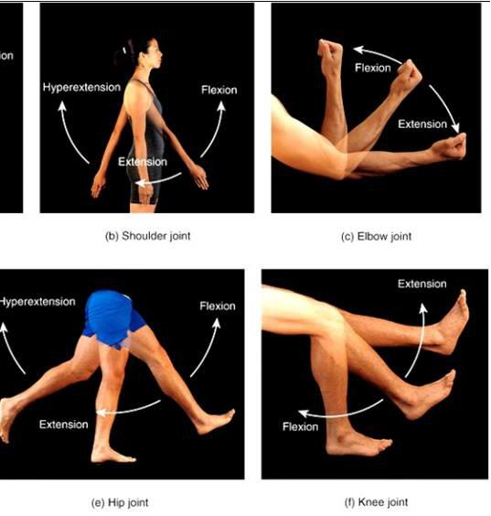
4.3.9 State the relationship between angular momentum, moment of inertia and angular velocity.
Angular movement is also called rotational movement.
Angular movement is rotation around a central axis.
For a spinning athlete the center of rotation often corresponds to center of mass
(Levers are an angular/rotational- movement around the fulcrum)

Slide 14
All of the vector qualities of linear movement described earlier also apply to angular movement. (displacement, velocity, momentum, force, etc.)
Just replace meters in the measurements with degrees or radians (of a circle)
The force needed to cause a rotational movement goes by the name Torque
Moment of Inertia- How much Torque is needed to cause rotation. It increases as center of mass gets farther from the axis.

Slide 15
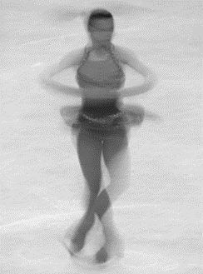
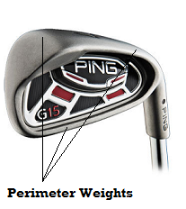
4.3.10 Explain the concept of angular momentum in relation to sporting activities.
Spinning ice skater or diver, Torque in a golf club
A skater will have a smaller moment of inertia with mass CLOSE to axis (arms in) and therefore will spin faster with arms in
Skater spin video
Golf club manufactures disperse mass AWAY from axis of rotation to make it harder for club to turn on impact

Slide 16
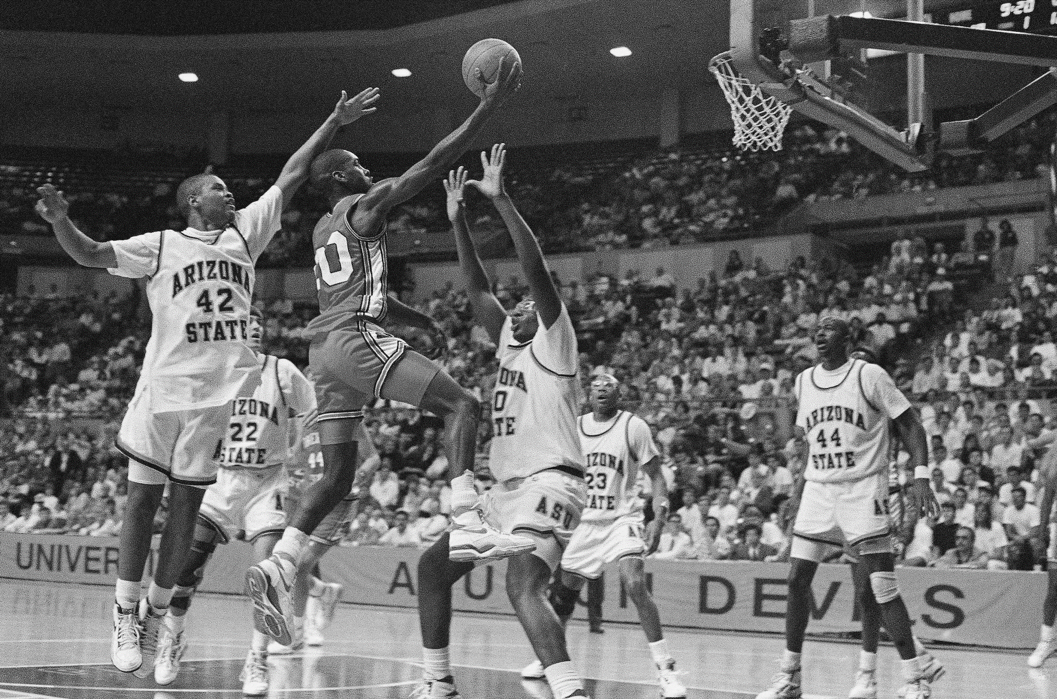
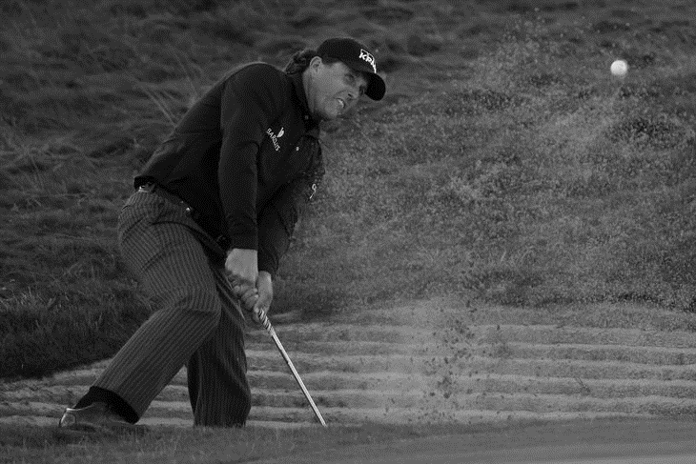
4.3.11 Explain the factors that affect projectile motion at take-off or release.
Velocity at release
Angle of release
Height of release point
Of course OTHER FORCES can affect motion after release.

Slide 17
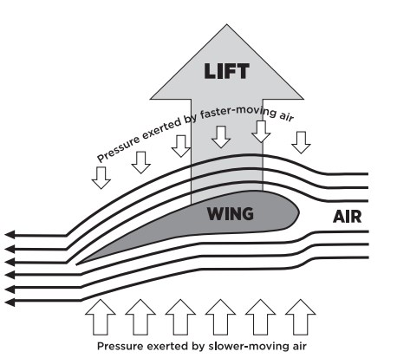
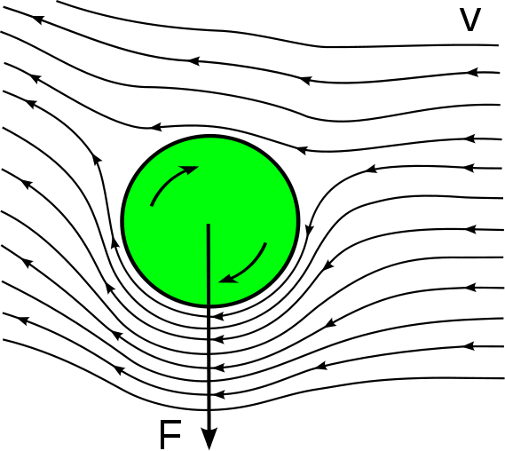
4.3.12 Outline the Bernoulli principle with respect to projectile motion in sporting activities
Bernoulli's principle - an increase in the speed of a fluid occurs simultaneously with a decrease in pressure
It’s how planes fly. Air speed over wing is faster so lower pressure creates lift
Magnus Effect - a spinning ball (or cylinder) curves away from straight flight path.
Air flow is faster on the side of the ball toward which it is spinning creating lower pressure. Balls turn in direction which they are spinning
Bend it like Beckham (and a bunch of other dudes) , Bubba out of the pinestraw at the Masters, Clayton Kershaw nasty curve, High altitude basketball drop

